Slide 1
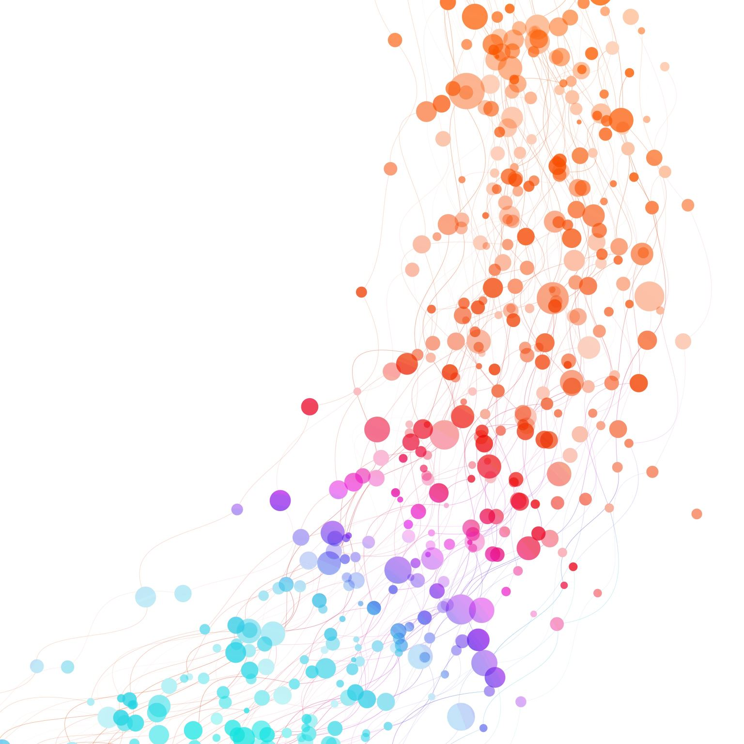
Polyps Segmentation in Colonoscopy
By: Pranjal Sharma,
Hanisha Kasaraneni

Slide 2


Team Members
Pranjal Sharma
Hanisha Kasaraneni

Slide 3
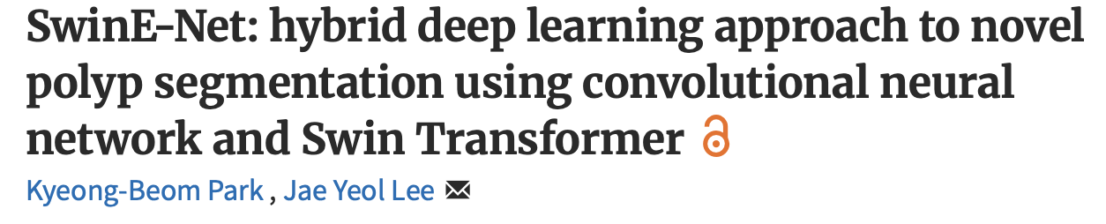
Our Project
KVASIR
ClinicDB
Notes:
Combines local details from CNN and global details from swin Transformers
0.91 Unet

Slide 4
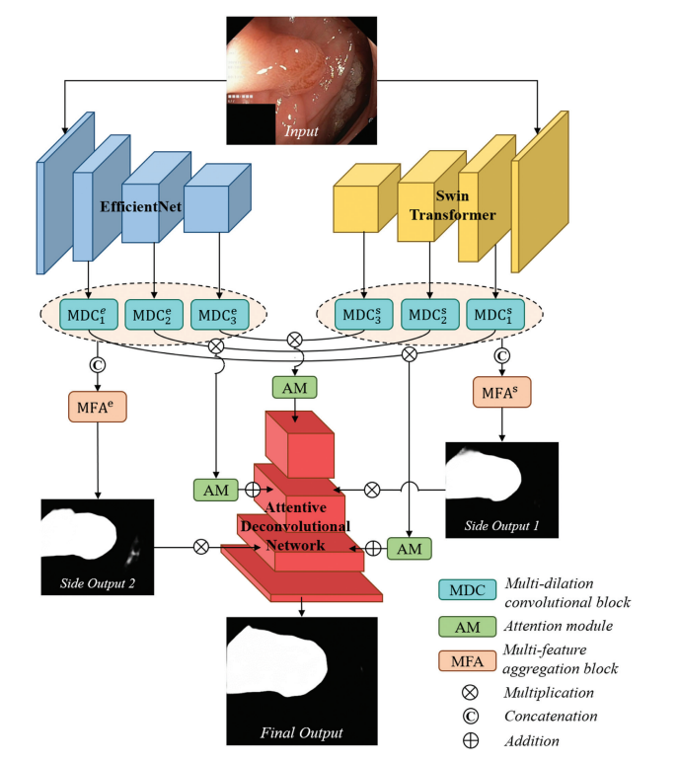
Recap – Paper’s Architecture
Input: RGB image
Encoders: EfficientNet + Swin Transformer (in parallel)
Feature Refinement: Multi-Dilation Convolution
Fusion & Supervision: Multi-Feature Aggregation + side outputs
Decoding: Attention + Inception-Res blocks → upsample
Output: Final segmentation mask
Notes:
Decoding: Attention + Inception-Res blocks → upsample means
“in the decoder stage we apply an attention module, then an Inception-Res block to refine features, and then upsample the result—repeating as needed until we reach full resolution.”
We don’t save the side outputs

Slide 5
Dataset
Feature | Kvasir-SEG | ClinicDB
Number of images | 1000 | Approx. 612
Image resolution | Varies from 332×487 to 1920×1072 pixels | 384×288 pixels
Annotation type | Pixel-level segmentation masks | Pixel-level segmentation masks
Content | Gastrointestinal polyp images | Endoscopy images from clinical practice
Data source | Public research dataset | Clinical collection
Image format | JPEG | TIF
Challenges | Variability in polyp size and shape | Lighting variation, occlusions, noise

Slide 6
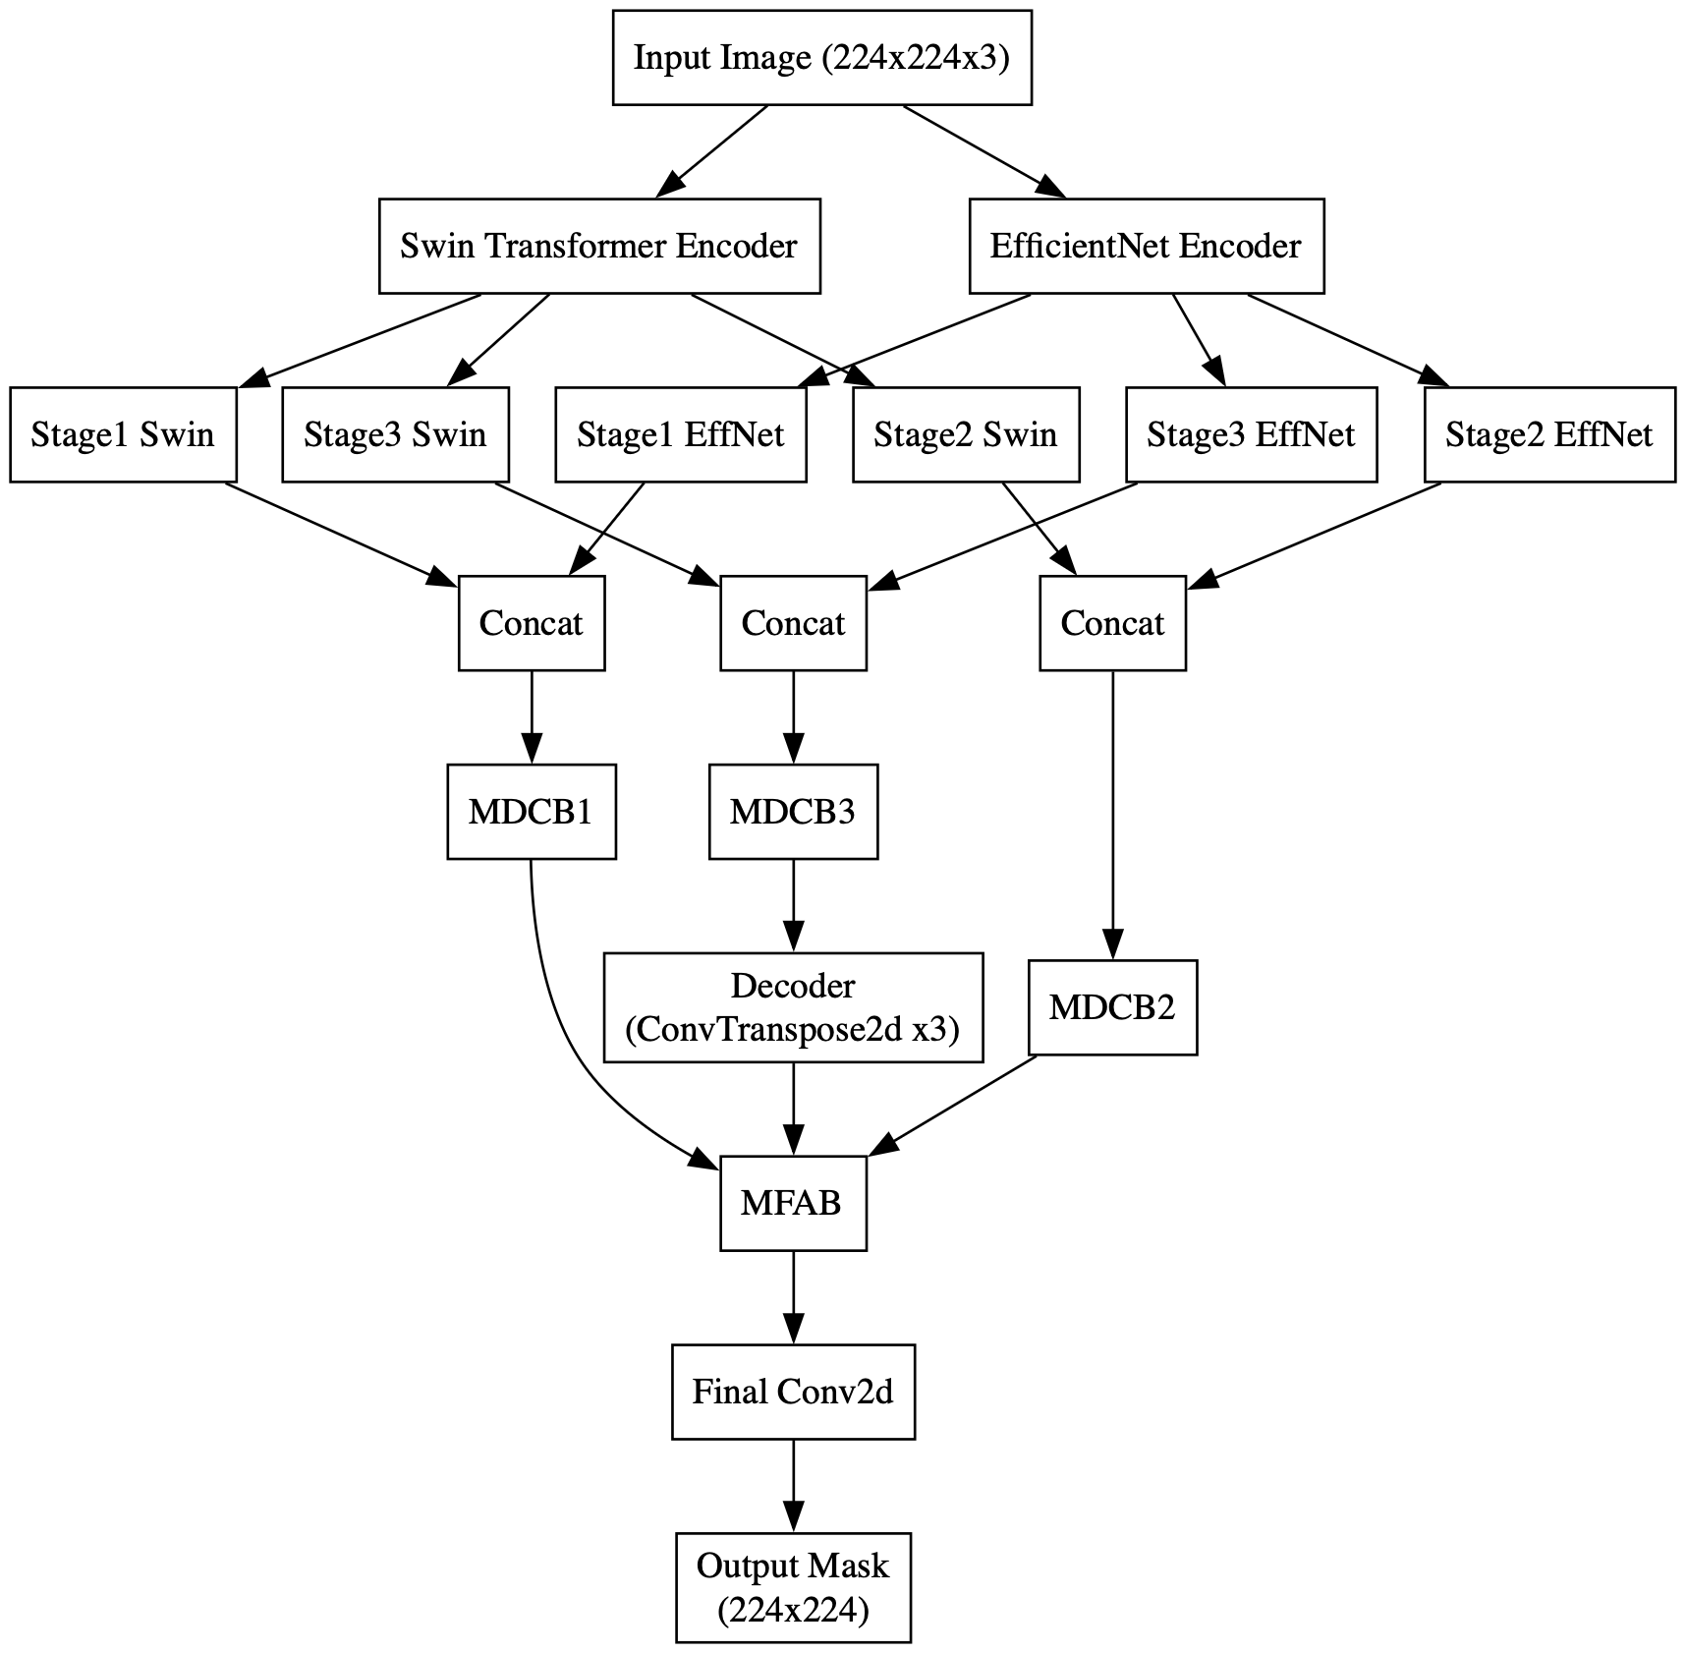
Implementation SwinE-Net
Figure: Architecture Diagram of New Implementation
Notes:
Stages are for the depth of features
EfficientNet are great at spotting local edges and textures, but their “view” is too narrow—they miss global context
MDCB3 receives the deepest, most abstract features—these contain the most global context, which is essential for the decoder to "start" reconstructing the segmentation mask.
MFAB Multi-Feature Aggregation (MFA): - Aggregates features from different levels (e.g., outputs of MDCB blocks) that may have different spatial resolutions.Resizes (typically upsampling) all feature maps to a common resolution (usually the highest, finest scale).
MDCB3 receives the deepest, most abstract features so we upsample
The final Conv2d layer is typically a 1×1 convolution applied to the feature map output by the MFAB block (or the last decoder block).
This layer maps the multi-channel feature map (from the network) to the number of output classes required for segmentation.
While only MDCB3's output enters the decoder directly, MDCB1 and MDCB2's outputs are not discarded. Instead, after the decoder upsamples the MDCB3 features, it incorporates features from MDCB1 and MDCB2 (typically through skip connections or aggregation blocks like MFAB).This multi-scale fusion allows the model to combine global context from deep layers (MDCB3) with fine details from shallow layers (MDCB1, MDCB2) for accurate segmentation.

Slide 7
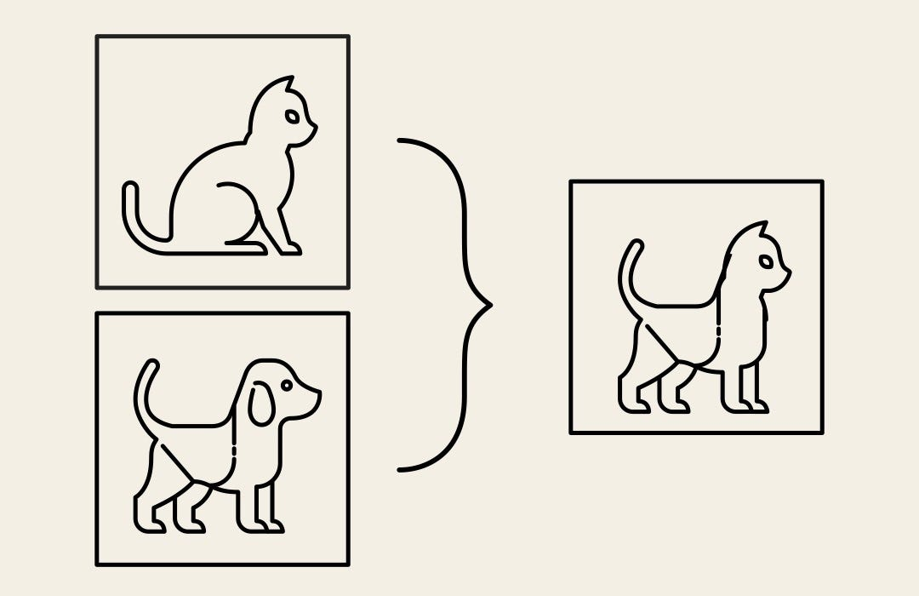
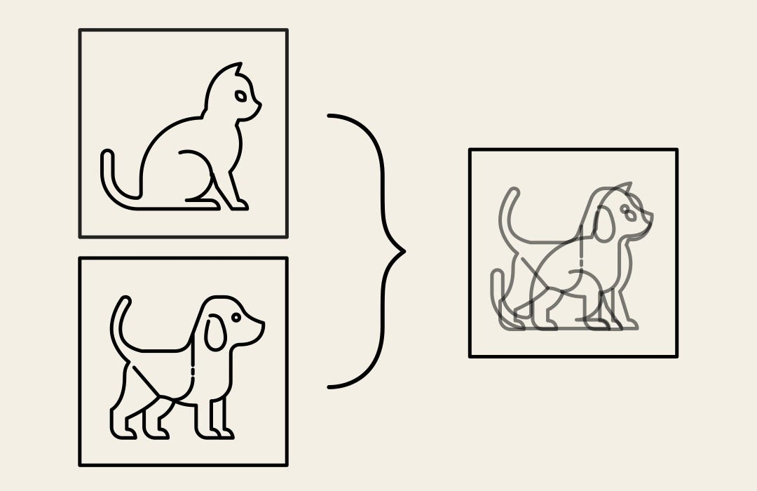
Key Differences in Architecture
We used Albumentations for image augmentation, including flips, rotations, brightness adjustments, CutMix, and MixUp for stronger generalization
We replaced bilinear upsampling with ConvTranspose2d
CBAM retained but MDC/MFA simplified into UpsampleBlock
Notes:
Albumentations- a technique that involves artificially expanding the size of a dataset by creating new images through various transformations such as rotation, scaling, flipping, and color adjustments.
ConvTranspose2d: It learns convolutional filters that upsample the input feature map to a higher resolution.
The filter weights are learned during training, so the network can adapt how it generates details at higher resolutions.
We get better results even with simpler MDC/MFA block
MDCB uses just parallel dilated convolutions + concat + 1x1 conv.
MFAB simply resizes, concatenates, and passes through a 1x1 conv.

Slide 8
What We Did Differently
Component | SwinE-Net (Paper) | Our Implementation
Upsampling | Bilinear + Conv | ConvTranspose2d (Deconvolution)
Decoder Design | Modular MDC, MFA, CBAM | Simplified UpsampleBlock + CBAM
Loss Function & Training | Weighted BCE + IoU | Weighted BCE + IoU + scheduler + Weight decay
Data Augmentation | Basic (Rotation, Flip, Scaling) | Albumentations + CutMix + MixUp
Notes:
Elastic transform introduces natural like changes artificially
An affine transformation is a geometric transformation that preserves lines and parallelism but not necessarily distances or angles
Reduce-on-plateau: Lowers the learning rate when a metric (e.g., validation loss) stops improving.
Weight decay is a regularization technique that adds a penalty to the loss function based on the magnitude of the model weights (usually L2 norm). This discourages the model from fitting to noise and helps prevent overfitting by keeping the model weights small.

Slide 9
Experiment Results Comparision
Exp | Loss function | Epochs | Description | Dataset | mDice | mIoU | Accuracy
1 | BCEwithLogitsLoss | 6 | Metrics for Training only | Kvasir | 0.949 | 0.927 | 0.987
2 | BCEwithLogitsLoss | 6 | Split Train:Test::9:1 | Kvasir | 0.894 | 0.832 | 0.969
3 | Weighted Loss Function | 5 | Added weighted loss function | Kvasir | 0.906 | 0.842 | 0.971
4 | Weighted Loss Function | 5 | Added ClinicDB | Kvasir + ClinicDB | 0.90 | 0.841 | 0.975
5 | Weighted Loss Function | 15 | Tried SwinV2 transformer | Kvasir + ClinicDB | 0.875 | 0.802 | 0.969
6 | Weighted Loss Function | 15 | Advance augmentation (mixup/cutmix) + optimizer with weight decay + Reduce on Plateau Scheduler | Kvasir + ClinicDB | 0.899 | 0.865 | 0.978
6A | Weighted Loss Function | 15 | Same as above. Only evaluated on Kvasir dataset | Kvasir + ClinicDB | 0.928 | 0.866 | 0.976
6B | Weighted Loss Function | 15 | Same as above. Only evaluated on ClinicDB dataset | Kvasir + ClinicDB | 0.907 | 0.830 | 0.982
7 | Weighted Loss Function | 15 | Changed Reduce on Plateau Scheduler to Cosine Annealing | Kvasir + ClinicDB | 0.892 | 0.858 | 0.977
Table: Experiment Results For New Implementation
Kvasir-SEG
ClinicDB
Table: Experiment Results from Original Paper
Notes:
Multiple scheduler: multistep scheduler, cosine annealing, cyclic lr
MDice penalizes false negatives while MIou penalizes both false positives and false negatives

Slide 10
Insights from Experiments
Best Dice: 0.928 with Weighted Loss Function on Kvasir (Advanced Augmentation, Optimizer with Weight Decay, Scheduler)
Best IoU: 0.866 with Weighted Loss + Aug (Exp 6A)
Best Accuracy: 0.982 on ClinicDB (Exp 6B)
Weighted loss function, advanced augmentation, scheduler, and optimizer with weight decay boost generalization

Slide 11
Pros and Cons
Pros
Easier to debug and train compared to complex original SwinE-Net decoder (with MDC, MFA).
Swin Transformer + CBAM give global + local attention without excessive compute.
Advanced augmentations (CutMix, MixUp) and regularization help perform well on unseen data.
Outperforms original model in Dice for Kvasir-SEG dataset.
Cons
CBAM is used lightly—more aggressive attention stacking might improve boundary detail.
Performance on real-time or video-sequence inference isn’t measured.
Our model only segments polyps, not classifies them as benign/malignant.

Slide 12
Project Timeline
 | Pranjal | Hanisha
Week 0 | PPT-1 | PPT-1
Week 1 - Kickoff | Literature Review | Understand SwinE-Net architecture
Week 2 – Dataset collection and Preprocessing | Gather Dataset | Dataset cleaning
Week 3 (27.5)– CNN and Transformer model setup | Implement E-Net based CNN feature extractor | Implement Swin Transformer
Week 4 – Architecture development | Integrate E-Net and Swin Transformer | Implement a multi-dilation convolution block and a multifeatured aggregation block
Week 5 (10.6)- Decoder and Attention Mechanisms | Implement an attentive deconvolution network | Integrate and test the convolutional block attention module (CBAM)
Week 6 – Loss function and Training Setup | Implement the loss function Prepare PPT-2 | Set up the training pipeline Prepare PPT-2
Week 7 (24.6) - Training the Model PPT-2 | Train and adjust the model | Conduct initial testing and evaluate early performance
Week 8 – Evaluation & Fine Tuning | Evaluate model performance on unseen datasets (Maybe not) | Fine Tuning
Week 9 – Verification and Report Creation | Verify results and processes, clean the git, verify documentation | Finalize report
Week 10 (July 15) | Project Presentation-3 and Report Submission

Slide 13

Meeting dates for practical
2nd May – Came up with the idea and started the presentation together.
3rd May - Completed the presentation and came up with a plan for going forward together.
7th May – Started literature review and understanding of the model together
9th May - Started gathering the dataset and dataset cleaning together
14th May - CNN and Transformer model setup
20th May - Architecture development
29th May - Decoder and Attention Mechanisms
3rd June - Implement the loss function
7th June - Set up the training pipeline
15th June – Solving the errors in the code
19th June – Working on the presentation and training the Model
23rd June – completed second presentation
1st July – Started Initial testing and evaluation
8th July – Fine Tuning and Report editing
12th July - verify documentation and preparing the PPT
14th July – final editing

Slide 14
Conclusion
The model outperforms the original SwinE-Net in Dice with a clean decoder.
Advanced augmentation + loss tuning led to significant improvements.
Reproducible, modular, and suitable for real-world deployment.
Future work: more diverse datasets, real-time segmentation.

Slide 15

Questions & Feedback
GitHub: http://github.com/djdubeyji/SwinE-Net

Slide 16

Thank you

